Slide 1
STAT 350 Review – Exam 2
Chris Womble

Slide 2
Observational Study vs Experiment
Observational Study: nothing is deliberately changed/manipulated, just observed. (Like a survey or interview scenario)
Experiment: Has a treatment that’s applied to the subjects to measure the impact on some response variable
Three principles of good experimental design
Control
Randomization
Replication
Anecdotal Evidence: A story, personal experience, not scientifically valid (usually memorable because it’s unusual)

Slide 3
Observational Study vs Experiment
Correlation does not imply causation!
Causation can (almost) never be inferred from an observational study (it can under certain conditions, but it’s difficult). You usually need a well-designed experiment to show that.
What implies causation? (from Producing Data handout)
1. The association is strong
2. The association is consistent
a. The association is repeatable
b. The same association happens under varying conditions. For example, lower doses are associated with low responses and higher doses associated with higher resonances always.
3. Alleged cause precedes the effect
4. The alleged cause is plausible

Slide 4
Experiment Terms (know the concepts)
Experimental Unit: the subject/individual that the treatments are applied to and responses are measured on
Response Variable: what result is being measured
Explanatory Variable: what is being manipulated/changed deliberately (also: factor)
Level: a particular value/”setting” of a factor
Treatment: a particular condition applied to an experimental unit. (If only one factor, then the treatments are the factor levels. If multiple factors, the treatments are the combinations of factor levels.)

Slide 5
Sampling
Simple Random Sample (SRS): Every member of the population has equal chance of being selected.
Stratified Random Sampling: First the population is divided up into groups (“strata”). Then an SRS is taken from each group (“stratum”).
Choose 50 random households from each county in Indiana
Convenience Sample: Not random (sample people in given location)
Sampling Problems…
Bias: results are systematically skewed one way or the other, or subjects are systematically left out (intentionally or unintentionally) (undercoverage)
Nonresponse: people can’t be reached or refuse to respond

Slide 6
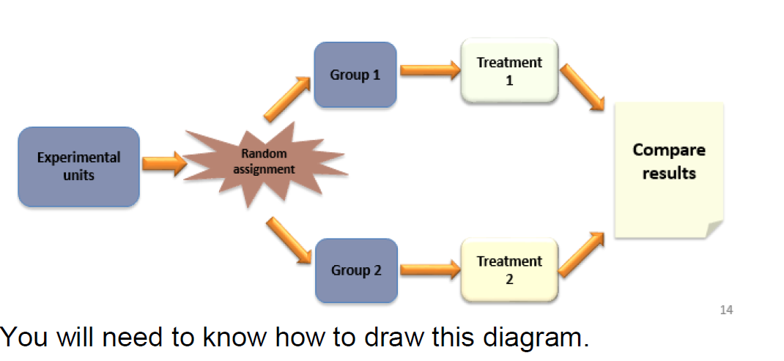
Experiments
See HW 6 Solutions for more examples.

Slide 7
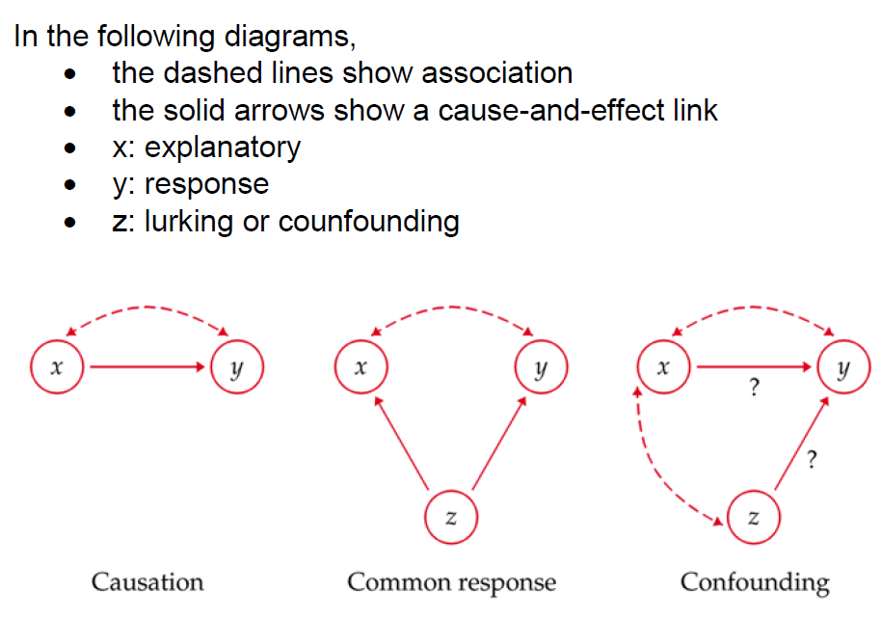
Lurking/Confounding Variables

Slide 8
Lurking/Confounding Variables
Common Response: x doesn’t influence y; z influences both x and y, so it looks like x influences y. (Shoe size and reading level? See: age.)
Confounding: x may influence y; z also influences y (but doesn’t directly influence x). (x could be hours studied; y could be exam score; z could be hours of sleep the night before the exam)

Slide 9

Chapter 8 – Confidence Intervals
Remember, a “better” confidence interval is narrower (has a smaller margin of error).
What makes a CI narrower?
Larger sample size
Lower standard deviation (variance)
Lower confidence level
Think about it… In theory, a “100% confidence interval” (no such thing) would go from negative infinity to infinity. And a “0% confidence interval” (also no such thing) would not be an interval at all, but would just be the point estimate itself.

Slide 10
Chapter 8 – Confidence Intervals
When estimating µ, remember, it is some unknown but fixed value
We’re trying to estimate it with sample information (X̄, s, n…)
So the sample (and resulting interval) is what’s random – not the true (unknown) mean µ.
Confidence level is based on the process. If we repeated the process of sampling n units and creating a 95% CI a very large number of times (with different samples), we’d expect 95% of the intervals to capture the true mean.
Incorrect to say there’s a “95% chance” that a given interval contains the true mean. Either it does or it doesn’t; we just don’t know, but the random part (the sampling) has already occurred, so this is not a “chance”/probability.

Slide 11
Chapter 8 – Confidence Intervals
Assumptions for a Z confidence interval
σ is known
Data are from a random sample
Underlying population is normal, AND/OR n is large
n > 30 central limit, or n < 30 but it is normal . Both ok
Assumptions for a T confidence interval
σ is unknown (but we have s from our sample)
Data are from a random sample
Underlying population is normal, AND/OR n is large
Note that conditions 2 and 3 are the same for both Z and T.

Slide 12
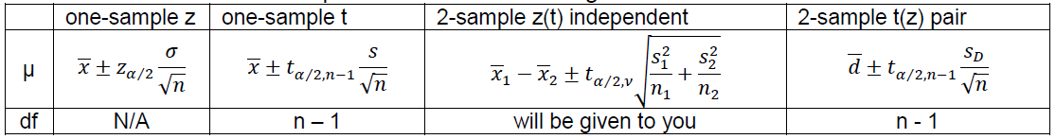
Chapters 8, 10 – Confidence Intervals
Know the formulas
Two-sample: when to use independent vs paired?
Paired only if there is some common characteristic tying the observations together (before and after score for the same person; husband and wife; older and younger sibling; etc...) There is 1:1 correspondence.
With paired, looking at the mean of the differences (d-bar).
With independent, looking at the difference between the means.
T alpha/2: two sided. Greater: one-side
2 sample: z or t, z does not have df, with sigma. T does have df, with s.

Slide 13
Chapters 8, 10 – Confidence Intervals
Interpret: “We are 95% (C%) confident that the population (true) mean of […] falls in the interval (a,b)” (or “is between a and b”).
For example, “We are 95% confident that the population (true) mean yield of this type of corn falls in the interval (121.4, 126.2)” (or “is between 121.4 and 126.2 bushels”).
So, to emphasize, include:
Confidence Level (“95%”)
“Population mean” (or “true mean”)
What it's the mean of (context) (“this type of corn”)
The actual interval (don't just say “the interval above,” for example, actually state it) (“between 121.4 and 126.2 bushels”)

Slide 14

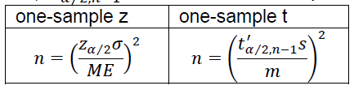
Chapters 8, 10 – Confidence Bounds
Confidence intervals are two-sided. There are also one-sided confidence bounds.
Note that instead of using z_{α/2}, z_{α} is used.
Also note that those are just the formulas for the Z confidence bounds. (T bounds follow same pattern)
Sample size calculations:
𝑡’_{𝛼⁄2,𝑛−1} is calculated for the preliminary study (the study that obtained s)
N round up
Degree of round down( assuming less info)

Slide 15
Chapters 9, 10 – Hypothesis Tests
Be able to use the 4 steps in hypothesis testing:
1. Identify the parameter(s) of interest and describe it (them) in the context of the problem situation.
2. State the Hypotheses.
3. Calculate the appropriate test statistic, df (if necessary), find the P-value (for z tests, you will need to be able to calculate this, for t tests, the value will be provided.)
4. Decision, reason for your decision including numbers, conclusion in the problem context.
Reject H₀ or fail to reject H₀ and why.
The data [does or might] [not] give [strong] support (P-value = [value]) to the claim that the [statement of H_{a} in words].
“The data gives strong support (p=0.001) to the claim that this medicine helps lower cholesterol.”

Slide 16
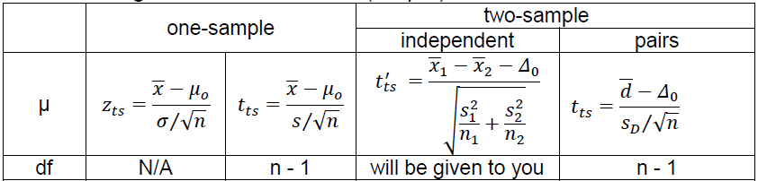
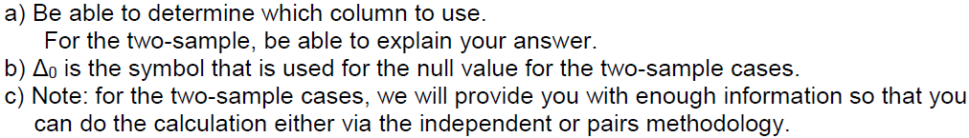
Chapters 9, 10 – Hypothesis Tests
Test Statistic

Slide 17
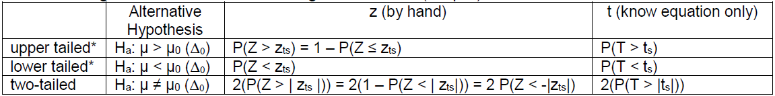
Chapters 9, 10 – Hypothesis Tests
P-value: the probability of obtaining a result at least as extreme (in the direction(s) of the alternative hypothesis) as the one observed, if H₀ were true. (How strong is our evidence against H₀?)
Lower = more significant (stronger). Reject if p < α.

Slide 18
Chapters 9, 10 – Hypothesis Tests
Type I error: when we incorrectly reject H₀ (H₀ was really true)
Probability of this is α
Type II error: when we incorrectly fail to reject H₀ (H₀ was really false)
Probability of this is ß
Power is 1 – ß: probability that we correctly reject H₀ for a given alternative value of µ.
How to increase power? All the same things that give you a narrower CI:
Larger sample size
Lower standard deviation
Higher α (less significant; lower confidence level)

Slide 19
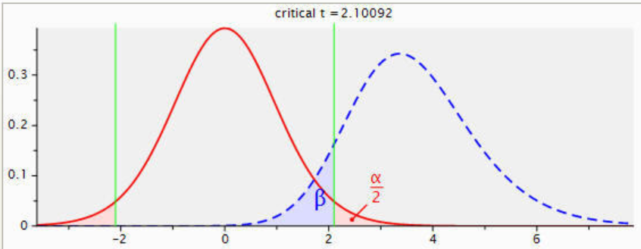
Chapters 9, 10 – Hypothesis Tests
Power Illustrated: (source: http://www.ats.ucla.edu/stat/gpower/one_sample4.jpg)
Red (left) curve represents distribution under H₀
Blue (right) curve represents distribution under H_{a}
Power is the non-shaded area under the blue (right) curve

Slide 20
Chapter 11 – ANOVA
Conceptually, a test to see if the variance between the groups is greater than the variance within the groups
ANOVA Assumptions:
Each population is Normally distributed
The population variances are equal ( max std / min std < 2 )
The samples are selected randomly and independently from each population
For the equal variances assumption: Look at the ratio of the largest standard deviation to the smallest. As long as it’s no greater than 2, the assumption is not considered violated.
Know your ANOVA table / how to fill it in (see review packet; see HW 10 solutions, problem 4b)

Slide 21
Chapter 11 – ANOVA
ANOVA uses F distribution.
Comparison:
t | F
2-sample independent | ANOVA
Same or different σ² | Same σ²
1 or 2 tailed | Only 2 tailed
Δ₀ ∈ real number | Δ₀ = 0
Only 2 levels | More than 2 levels

Slide 22
Chapter 11 – ANOVA
H₀: µ₁ = µ₂ = … = µ_{k}
H_{a}: At least two µ_{i}’s are different
If significant, what groups are different? Must use multiple comparison analysis.
Bonferroni can be good when only comparing some pairs of means
Tukey is better if comparing all pairs of means
Multiple comparison isolates which groups are different, so it’s only needed when the overall F test is significant.
Know CI formulas & interpretation (if it doesn’t contain 0, the difference is significant)

Slide 23
Chapter 11 – ANOVA
Visual (Graphical) Representation of Differences in Means:
Sort in Increasing Order
Draw Lines Connecting Those Not Significantly Different
For example, if X̅_{C}=1, X̅ _{A}=3.2, X̅_{D}=5, X̅_{E}=6, and X_{B}=10: Group 3 Group 1 Group 4 Group 5 Group 2 1 3.2 5 6 10 Interpretation: Groups 3 and 1 not significantly different Groups 1, 4, 5 not significantly different The rest are significantly different (3 and 4; 3 and 5; 3 and 2; 4 and 5; 4 and 2; 3 and 2; 1 and 2; 4 and 2; 5 and 2)
Be able to go either direction (construct and/or interpret the diagram)

